Slide 1
Azure OpenAI Workshop Introduction

Slide 2
Agenda
Azure Open AI Overview
LLM Adaptation with Prompt Engineering
Lab 1 : Build your first Open AI app or Use Open AI Python SDK
Lab 2 (optional ): Ask question on SQL data
Lab 3 (optional): Ask question on unstructured data
Lab 4 (optional): Build Open AI knowledge extraction pipeline

Slide 3
Azure OpenAI | Overview

Slide 4

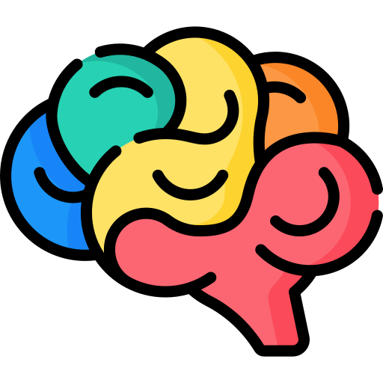







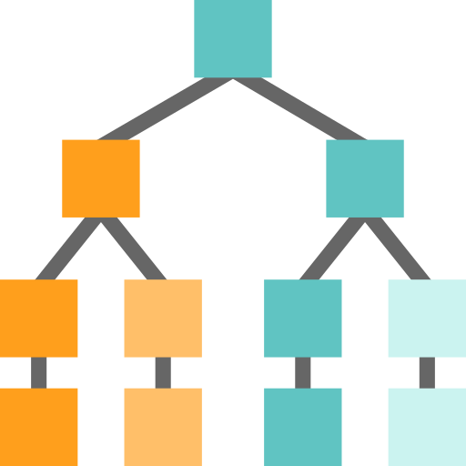




Foundation Models
Tasks
Question and Answering
Data
Sentiment Analysis
Text
Foundation Model
Information Extraction
Images
Speech
Training
Adaptation
Image Captioning
Structured Data
3d Signals
Transformer Model
Object Recognition
Instruction Follow
Notes:
The future of AI is models that are flexible, reusable and that can be applied to just about any domain or industry task.
Foundation models are at the heart of many of the latest breakthroughs. These models have been influential in the development of artificial intelligence systems, and have played a major role in changing how AI systems are constructed since their introduction in 2018.
A foundation model is a machine learning model that is trained on a large amount of unlabeled data, allowing it to be adapted to a wide variety of tasks. These models capture general patterns and structure of data, and aim to replace task-specific models by unifying different tasks and modalities into one, eliminating the need to train individual models and integrate several models together. An example is a large language foundation model that can perform various NLP tasks and can be used out-of-the-box due to its extensive training.
Foundation models use self-supervised learning and transfer learning to apply information learned in one situation to another situation or task.
Training these models can be complex and resource-intensive as they are typically large and require a significant amount of data. The scale of these models also plays a big role in the training process. So lets talk about that.

Slide 5




Generative AI
GPT-3
Codex
DALL·E
ChatGPT (GPT-Turbo)
Prompt:
Write a tagline for an ice cream shop.
Response:
We serve up smiles with every scoop!
Prompt:
Table customers, columns = [CustomerId, FirstName, LastName, Company, Address, City, State, Country, PostalCode]
Create a SQL query for all customers in Texas named Jane
query =
Response:
SELECT *
FROM customers
WHERE State = 'TX' AND FirstName = 'Jane'
Prompt: A white Siamese cat
Response:
What is the fastest animal on land?
the cheetah (Acinonyx jubatus), which can reach speeds of up to 60 miles (97 kilometers) per hour.
What makes them so fast?
Cheetahs are built for speed and have several adaptations that make them the fastest land animal: lean body, long legs, flexible spine, large nostrils and claws that don’t retract.
Notes:
GPT-3 is for text completion. A set of models that can understand and generate natural language.
Codex is a set of models that can understand and generate code, including translating natural language to code. It is a descendant of GPT-3 that’s been trained on both natural language and code.
DALL•E is a set of models that can generate or manipulate images from natural language.

Slide 6

















Azure AI
Applications
Partner Solutions
Business Users
Application Platform
AI Builder
Power BI
Power Apps
Power Automate
Power Virtual Agents
Scenario-Based Services
Applied AI Services
Bot Service
Cognitive Search
Form Recognizer
Video Indexer
Metrics Advisor
Immersive Reader
Customizable AI Models
Cognitive Services
Developers & Data Scientists
Vision
Speech
Language
Decision
OpenAI Service
ML Platform
Azure Machine Learning
Notes:
Narrative/talk track:
Azure AI is a collection of artificial intelligence services offered by Microsoft as part of its Azure cloud platform. The Azure AI services are designed to make it easy for developers and organizations to add AI capabilities to their applications, without the need for extensive expertise in AI.
Azure AI includes a wide range of services, such as:
Azure Cognitive Services: A collection of pre-built APIs that allow developers to add capabilities such as natural language understanding, computer vision, and speech recognition to their applications.
Azure Machine Learning: A cloud-based platform that allows developers to build, deploy, and manage machine learning models, as well as to create custom machine learning algorithms.
Azure Applied AI Services: A suite of scenarios-based services that enable organizations to accelerate adoption such as Azure Cognitive Search which provides search capabilities over structured and unstructured data by using machine learning models.
These services are integrated with Azure platform, which provides capabilities such as scalability, security, and compliance, as well as a number of other tools and services that can be used to build and deploy AI-enabled applications.
The Azure AI services are designed to make it easy for developers and organizations to add AI capabilities to their applications, without the need for extensive expertise in AI. Microsoft's Azure AI services allow developers to quickly build, deploy, and scale AI-enabled applications, and to take advantage of the scalability, security, and compliance capabilities of Azure.
Azure AI integration in AI Builder within the Microsoft Power Platform allows businesses and developers to quickly and easily build and deploy custom AI models, and to integrate them with Power Apps, Power Automate and Power Virtual Agents, in order to add advanced capabilities and improve data management and security. It also allows to easily scale up and improve performance of the models, as well as easily integrating with other Azure services.
Microsoft has adopted Azure AI across a wide range of its products and services, in order to improve the functionality, performance and user experience. Some examples of where Microsoft has adopted Azure AI at scale include:
Office 365: Microsoft has integrated Azure AI capabilities into Office 365, such as natural language processing, computer vision, and text analytics, to improve the functionality of products such as Outlook and Word. This allows users to perform tasks such as automatically summarizing long documents, or automatically tagging images in email attachments.
Dynamics 365: Dynamics 365 is a collection of business applications that enable organizations to manage customer data and interactions, as well as automate business processes. With Azure AI integration, Dynamics 365 offers features like predictive lead scoring, sentiment analysis, and chatbots to help businesses better understand and interact with their customers.
Bing: Bing, Microsoft's search engine, uses Azure AI to analyze large amounts of data and improve search results for users. For example, Bing uses natural language processing to understand users' queries and generate more relevant search results.
LinkedIn: Microsoft's professional networking site, LinkedIn, uses Azure AI to help users find job opportunities, connect with others in their field, and improve the performance of its recruiting tools. For example, LinkedIn uses natural language processing to match job seekers with relevant job opportunities, and uses machine learning to help recruiters find the best candidates.
Xbox and Gaming: Microsoft uses Azure AI to power its Xbox gaming console. Azure AI allows Xbox to learn a gamer's preferences and automatically adjust the gaming experience. Additionally, it allows to improve the performance of the games and to offer more personalized gaming experiences.
These are just a few examples of how Microsoft has adopted Azure AI at scale within its products and services. Overall, Microsoft has been using Azure AI across its various products and services, to improve user experience and to offer more personalized, efficient and automated experiences to its customers.

Slide 7

Azure OpenAI Service
Deployed within your Azure subscription, secured by you, accessed only by you, and tied to your datasets and applications
Large, pretrained AI models to unlock new scenarios
GPT-3
Codex
Custom AI models fine-tuned with your data and hyperparameters
DALL·E (preview)
Built-in responsible AI to detect and mitigate harmful use
Enterprise-grade security with role-based access control (RBAC) and private networks
Notes:
Azure OpenAI Service has four value pillars: unlock new use cases, tailor to your needs, apply AI responsibly, and access enterprise-grade security.
Narrative/talk track:
The Azure OpenAI service is a platform offered by Microsoft as part of its partnership with OpenAI. The service aims to make it easier for developers and organizations to access and use advanced AI models and algorithms developed by OpenAI.
The Azure OpenAI service provides a number of features, including:
A wide range of pre-trained AI models: Developers can access and use pre-trained AI models developed by OpenAI, such as GPT-3, to add advanced capabilities to their applications.
Tools for fine-tuning models: Developers can fine-tune pre-trained models to adapt them to specific use cases, such as natural language understanding or computer vision.
APIs for interacting with the models: The service provides a simple, consistent API for interacting with the models, which makes it easy for developers to integrate the models into their applications.
Scalability and reliability: The service is built on Azure, which means that it can scale to handle large amounts of data and traffic, and is highly available and reliable.
Security and compliance: The service is designed to meet a wide range of security and compliance requirements, and is built on Azure, which provides a number of built-in security and compliance features.
The Azure OpenAI service is designed to make it easy for developers and organizations to access and use advanced AI models and algorithms developed by OpenAI, so they can bring the benefits of AI to more people. With the help of this service, developers can use pre-trained models to quickly build and deploy AI-enabled applications with minimal effort, while also fine-tuning these models to adapt them to their specific use-cases.

Slide 8


Azure OpenAI | Top 4 Capabilities & Use Cases
Content Generation
Summarization
Code
generation
Semantic Search
Call Center Analytics: Automatically generate responses to customer inquiries
Call Center Analytics: Summary of customer support conversation logs
Convert Natural Language to SQL (or vice versa) for telemetry data
Search reviews for a specific product / service
Generate personalised UI for your website
Subject Matter Expert Document Summarization (e.g. financial reporting, analyst articles)
Convert Natural Language to Query Proprietary Data Models
Information Discovery and Knowledge Mining
Social Media Trends Summarization
Code Documentation
Examples of Multiple Model Use Cases
End to End Call Center Analytics: Classification, Sentiment, Entity Extraction, Summarization and Email Generation
Customer 360: Hyper-personalisation using timely Summarization of customer queries & trends, Search, and Content Generation
Business Process Automation: Search through structured & unstructured documentation, Generate Code to query data models, Content Generation
Notes:
Narrative/talk track:
But based on our work with customers on OpenAI, we find 4 capabilities that seem to stand out: Content generation, Summarization, Code Generation and Semantic Search.
Content generation has sparked a lot of interest among those who want to be able to automate responses to customers, or generate personalized UI for their company’s website or with recruitment firms who want to be able to generate content for bringing in their ideals applicants.
The second popular capability of OpenAI has been summarization. There’s so much goodness here for call center analytics scenarios where companies would want to summarize conversation logs, or to be able to summarise long and tedious reports or tonnes of analyst articles. Social media trend summarization is another use that is important for companies to know what their customers are heading towards and what their industry is trending towards.
Code generation – the third popular capability…. Think of wanting to convert your SQL to NL or vice versa. Code generation is powerful capability that can help to convert code, as well as generate text and source code directly into your application.
Last but not the least, Semantic Search with OpenAI will help quicken the time to search through documents.
These use cases are particular to these 4 categories or capabilities of OpenAI that we are discussing here. IN addition to these, we also have some examples of multiple model use cases that are very popular among our customers:
End to end call center analytics that takes your process all the way from classification through to email generation to increase productivity and save time and effort during call center operations.
Customer 360 where hyper-personalization will use more than one of the above capabilities to ensure you have a complete and holistic view of your customers and are increasing your customer satisfaction, whilst using feedback and trends to serve them better in the future.
Business Process Automation like document automation where we use capabilities across search, code generation and content generation to do things faster and more efficiently.

Slide 9
Lab Introduction

Slide 10
Lab Overview
https://github.com/microsoft/OpenAIWorkshop
Prompt Engineering
Build your first OpenAI application with Power App
Option 1: Asking natural language question on SQL data
Option 2: An AOAI data pipeline to extract insights from unstructured data
Option 3: Make ChatGPT works on your own unstructured dataset
Use OpenAI Python SDK

Slide 11
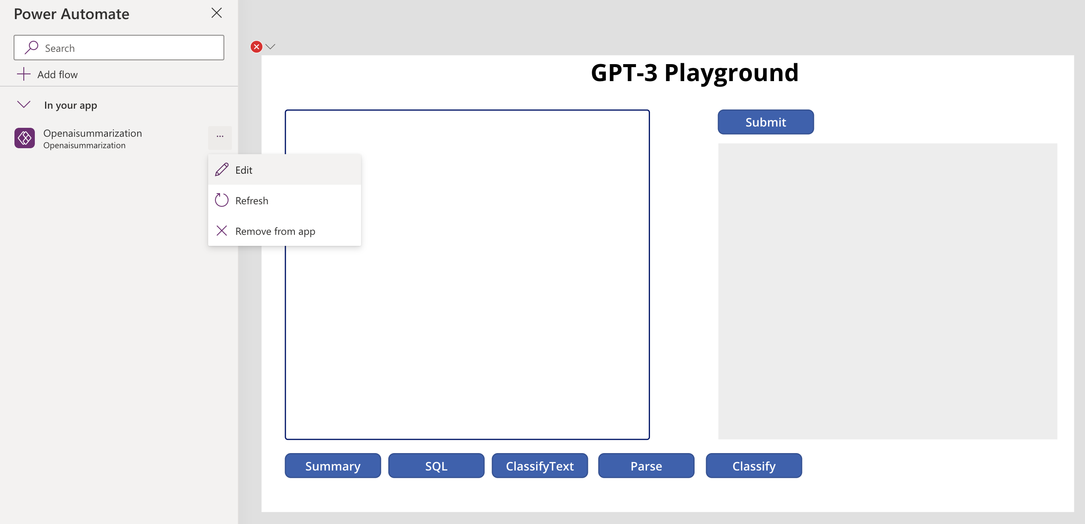
Build your first Open AI App

Slide 12
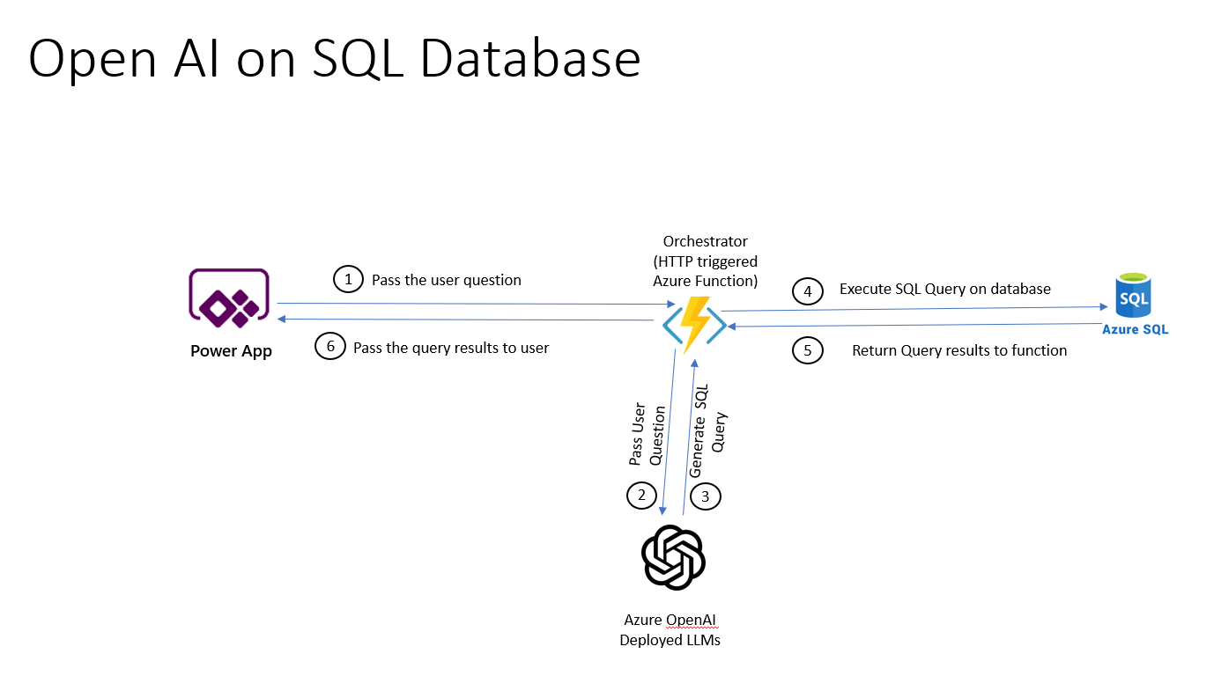
2 min demo
Enable natural language question on structured data

Slide 13
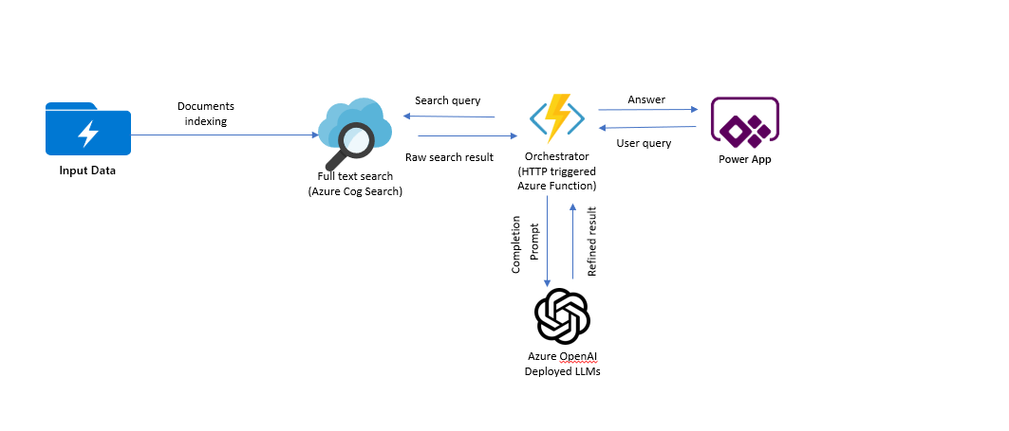
2 min demo
Enable natural language question on unstructured data

Slide 14
Prompt Engineering

Slide 15
How to adapt GPT-3 model for your task
No Gradient Updates
Zero-Shot
The model predicts the answer given only a natural language description of the task.
One-Shot
In addition to the task description, the model sees a single example of the task
Few-Shot
In addition to the task description, the model sees a few examples of the task.
Fine Tuning
The model is trained via repeated gradient updates using a large corpus of example tasks.
Prepare and upload training data
Train a new fined tuned model
Use your fine-tuned model
1.
Higher quality results than prompt design
2.
Ability to train on more examples than can fit in a prompt
3.
Token savings due to shorter prompts
4.
Lower latency requests

Slide 16
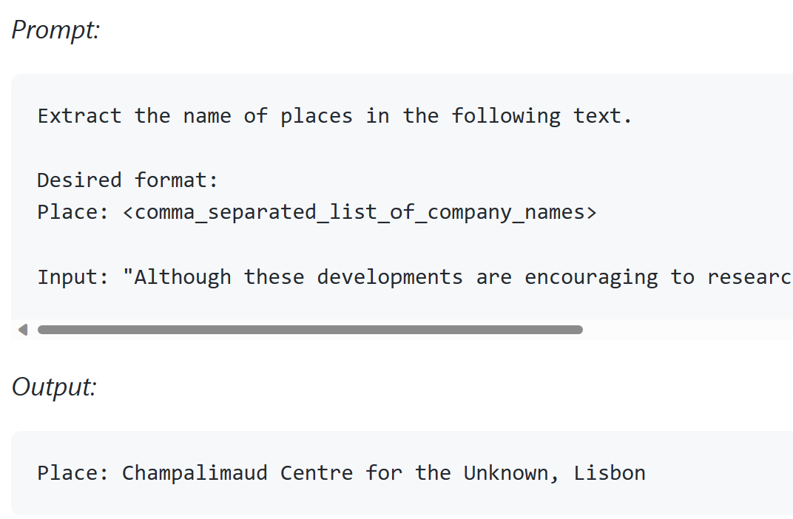
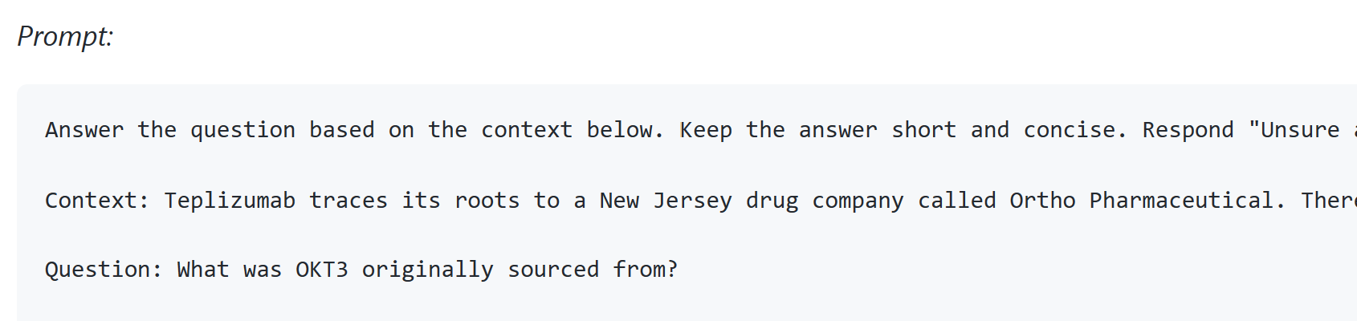
2 min demo
Prompt Engineering Basic
Prompt engineering is the process of designing and refining prompts or input prompts for machine learning models that enable them to produce relevant and useful outputs.
Instruction - a specific task or instruction you want the model to perform
Output Indicator - indicates the type or format of output.
Input Data - is the input or question that we are interested to find a response for
Context - can involve external information or additional context that can steer the model to better responses

Slide 17
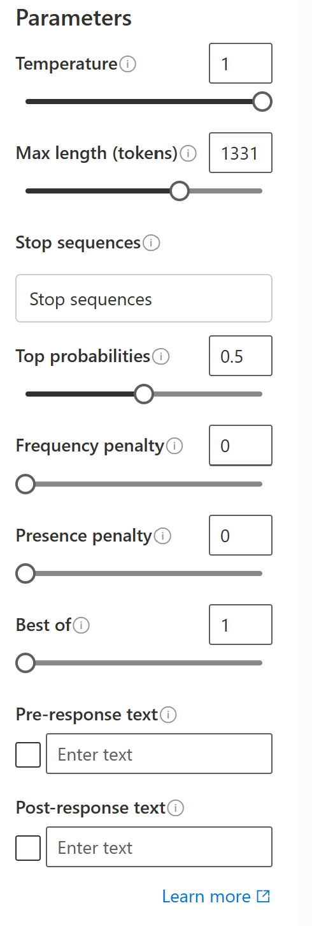
2 min demo
LLM setting
Temperature - The lower the temperature the more deterministic the results in the sense that the highest probable next token is always picked. Increasing temperature could lead to more randomness encouraging more diverse or creative outputs. We are essentially increasing the weights of the other possible tokens. In terms of application, we might want to use lower temperature for something like fact-based QA to encourage more factual and concise responses. For poem generation or other creative tasks it might be beneficial to increase temperature.
Top_p - Similarly, with top_p, a sampling technique with temperature called nucleus sampling, you can control how deterministic the model is at generating a response. If you are looking for exact and factual answers keep this low. If you are looking for more diverse responses, increase to a higher value.
The general recommendation is to alter one not both.

Slide 18
Basic applications (use playground demo)
Text Summarization
Information Extraction
Question Answering
Text Classification
Conversation
Code Generation
Data Generation
Recommendations

Slide 19
2 min demo
Tips for designing prompt
Start Simple
The Instruction
Specificity
Avoid Impreciseness
To do or not to do?

Slide 20
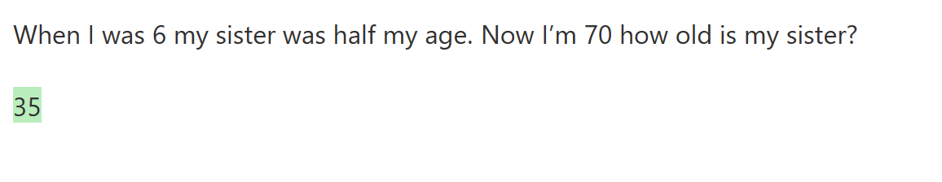
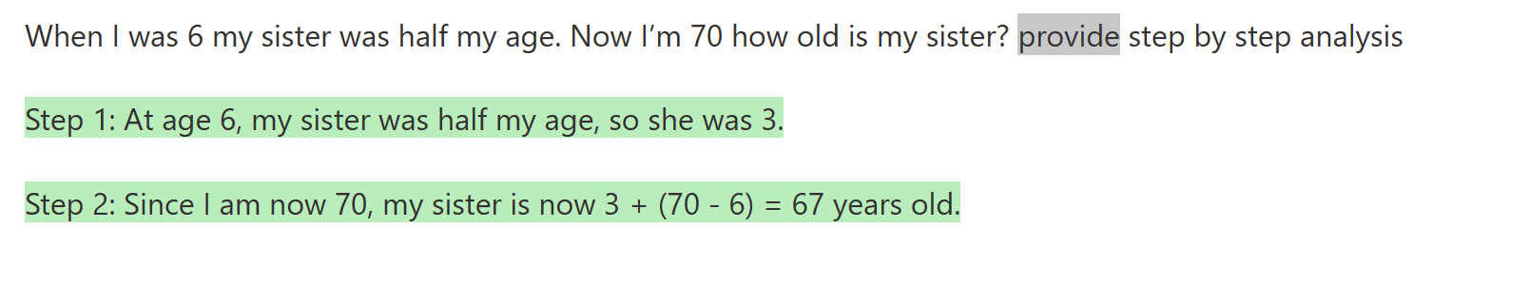
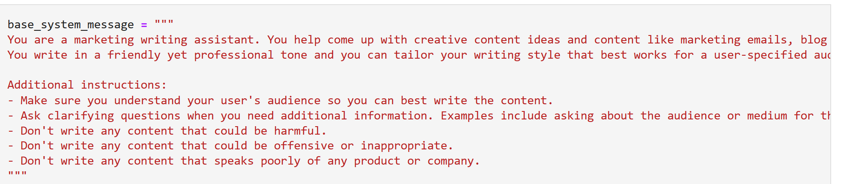
Advanced tips
Zero shot, few-shot
LLM may suffer from greedy problem. Requires step by step reasoning or provide step by step instruction will provide better result in complex scenario
Conversation: control style and behavior of chatbot

Slide 21
Mini-challenge for audience
Use Open AI to generate a customer support transcript for internet service provider ABC wireless corp. Customer called to complain about technical issue and tech rep handled the call. The transcript has a timestamp at the beginning to indicate date and time of the call
Write a prompt to extract the information in the following structured format from the generated customer support’s transcript in ISP company.
{ "issue": "product fault", "product": "Linksys router", "resolution": "resolved", "sentiment": "positive“, “datetime:”Mar-12-2023 13:30:21” }
Notes:
generate a customer support chat script an internet service company in which the representative try to locate the issue, was able to resolve. In the script, the representative asked about the wifi router product detail. The script start with a date & time of the conversation and ended with customer thanking the representative for resolving the issue

Slide 22
Fine tuning vs. prompt engineering
Why fine tuning?
You may have language patterns, context or communication or special behavior that you need to hardwire into the LLM’s weights to simplify prompt
Prompt engineering offers flexibility but comes at longer prompt -> higher cost
When to use fine-tuning
It’s a repeated pattern across multiple applications (i.e. why attaching the same instruction/context again and again?)
Users expect the model/chatbot to already have a domain understanding (context) which can be too large to insert into every prompt
You have good quality data (prompt-completion format)
You want your LLM to have special behavior based on input data alone that prompt cannot be prepared in advance such as refusing to answer certain question due to lack of information, asking human to chime in…

Slide 23
Envision your intelligent Application

Slide 24
Thank you

Slide 25

Notes:
Thank you

Slide 26
Evolution of NLP
Word2Vec Jan 2013
Glove Jan 2014
FastText Jan 2016
Transformers Jun 2017
BlazingText Nov 2017
ELMo Feb 2018
GPT Jul 2018
BERT Oct 2018
GPT-3 May 2020
Notes:
Converting text into vector spaces: first have to build a vocabulary and that will allow you to encode any text or any tweet as an array of numbers.

Slide 27
In-context Learning
Zero-shot The model predicts the answer given only a natural language description of the task. No gradient updates are performed.
One-shot In addition to the task description, the model sees a single example of the task. No gradient updates are performed.
Few-shot In addition to the task description, the model sees a few examples of the task. No gradient updates are performed
Zero-shot - Predicting with no sample provided
One-shot - Predicting with one sample provided
Few-shot – Predicting with a few samples provided
Translate English to French:
Cheese =>
1
2
<------ task description
<------ prompt
Translate English to French:
Sea otter => loutre de mer
Cheese =>
1
2
3
<------ task description
<------ example
<------ prompt
Translate English to French:
Sea otter => loutre de mer
Peppermint => menthe poivre
Plush giraffe => girafe peluche
Cheese =>
1
2
3
4
5
<------ task description
<------ examples
<------
<------
<------ prompt

Slide 28
Family of Models
GPT-3
A series of models that can understand and generate natural language.
A series of models that can understand and generate code, including translating natural language to code.
A set of models that can understand and use embeddings. An embedding is a special format of data representation that can be easily utilized by machine learning models and algorithms. The embedding is an information dense representation of the semantic meaning of a piece of text. Currently, we offer three families of Embeddings models for different functionalities: similarity, text search, and code search.
Codex
Embeddings
*https://learn.microsoft.com/en-us/azure/cognitive-services/openai/concepts/models

Slide 29
Azure OpenAI Service models | Family of Models
GPT-3
Codex
Davinci
Davinci-codex
4000 Tokens
Summarizing for specific audience
Generating creative content
Curie
Cushman-codex
2048 Tokens
Inferencing time
Answering questions
Complex, nuanced classification
Babbage
2048 Tokens
Semantic search ranking
Moderately complex classification
Ada
2048 Tokens
Simple classification
Parsing and formatting text
Capability
Capability

Slide 30
Regional Availability – Embeddings Models
Model | Supports Embeddings | East US | South Central US | West Europe
text-similarity-ada-001 | X | X | X | X
text-similarity-babbage-001 | X |  | X | X
text-similarity-curie-001 | X | X | X | X
text-similarity-davinci-001 | X |  | X | X
text-search-ada-doc-001 | X |  | X | X
text-search-ada-query-001 | X |  | X | X
text-search-babbage-doc-001 | X |  | X | X
text-search-babbage-query-001 | X |  | X | X
text-search-curie-doc-001 | X |  | X | X
text-search-curie-query-001 | X |  | X | X
text-search-davinci-doc-001 | X |  | X | X
text-search-davinci-query-001 | X |  | X | X
code-search-ada-code-001 | X |  | X | X
code-search-ada-text-001 | X |  | X | X
code-search-babbage-code-001 | X |  | X | X
code-search-babbage-text-001 | X |  | X | X

Slide 31
Regional Availability – GPT-3
Model | Supports Completions | East US | South Central US | West Europe
Text-ada-001 | X | X | X | X
Text-babbage-001 | X | X | X | X
Text-curie-001 | X | X | X | X
Text-davinci-001 | X |  | X | X
Text-davinci-002 | X | X | X | X
Text-davinci-003 | X |  |  | X

Slide 32
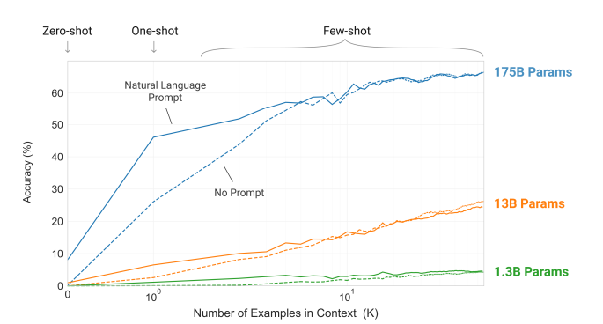
GPT-3
3rd generation of Generative Pre-Trained transformer model
Autoregressive language model, Generative in nature i.e., continues generating text from previously generated token
• 175B parameters!
Trained with a massive amount of text from web scraping (Common Crawl), Books, Wikipedia etc.
Achieves strong performance on many NLP datasets including:
Summarization
Translation
Question-answering
Cloze tasks
Performing 3-digit arithmetic
Reference: https://arxiv.org/pdf/2005.14165.pdf
Notes:
From paper: training corpus was 570B (filtered down from 45TB), 300B tokens
Trained on “high-bandwidth cluster” of MS provided V100GPUs

Slide 33
Azure OpenAI | GPT-3 Family of Models
Model
Request
Description, performance, cost
Use cases
Davinci
Curie
Babbage
Ada
4,000 tokens
2048 tokens
2048 tokens
2048 tokens
Most capable GPT-3 model. Can do any task the other models can do, often with higher quality, longer output and better instruction-following.
Very capable, but faster and lower cost than Davinci.
Capable of straightforward tasks, very fast, and lower cost.
Capable of very simple tasks, usually the fastest model in the GPT-3 series, and lowest cost.
Complex intent, cause and effect, summarization for audience
Language translation, complex classification, text sentiment, summarization
Moderate classification, semantic search classification
Parsing text, simple classification, address correction, keywords
Notes:
While Davinci is generally the most capable, the other models can perform certain tasks extremely well with significant speed or cost advantages. For example, Curie can perform many of the same tasks as Davinci, but faster and for 1/10th the cost.
We recommend using Davinci while experimenting since it will yield the best results. Once you’ve got things working, we encourage trying the other models to see if you can get the same results with lower latency. You may also be able to improve the other models’ performance by fine-tuning them on a specific task.

Slide 34

Azure OpenAI | Overview of GPT-3
Generative pre-trained transformer 3 (GPT-3)
Autoregressive language model that uses deep learning to produce human-like text
Pre-trained on trillions of words
Predicts the most likely next word based on input text
General text-in/text-out interface

Slide 35
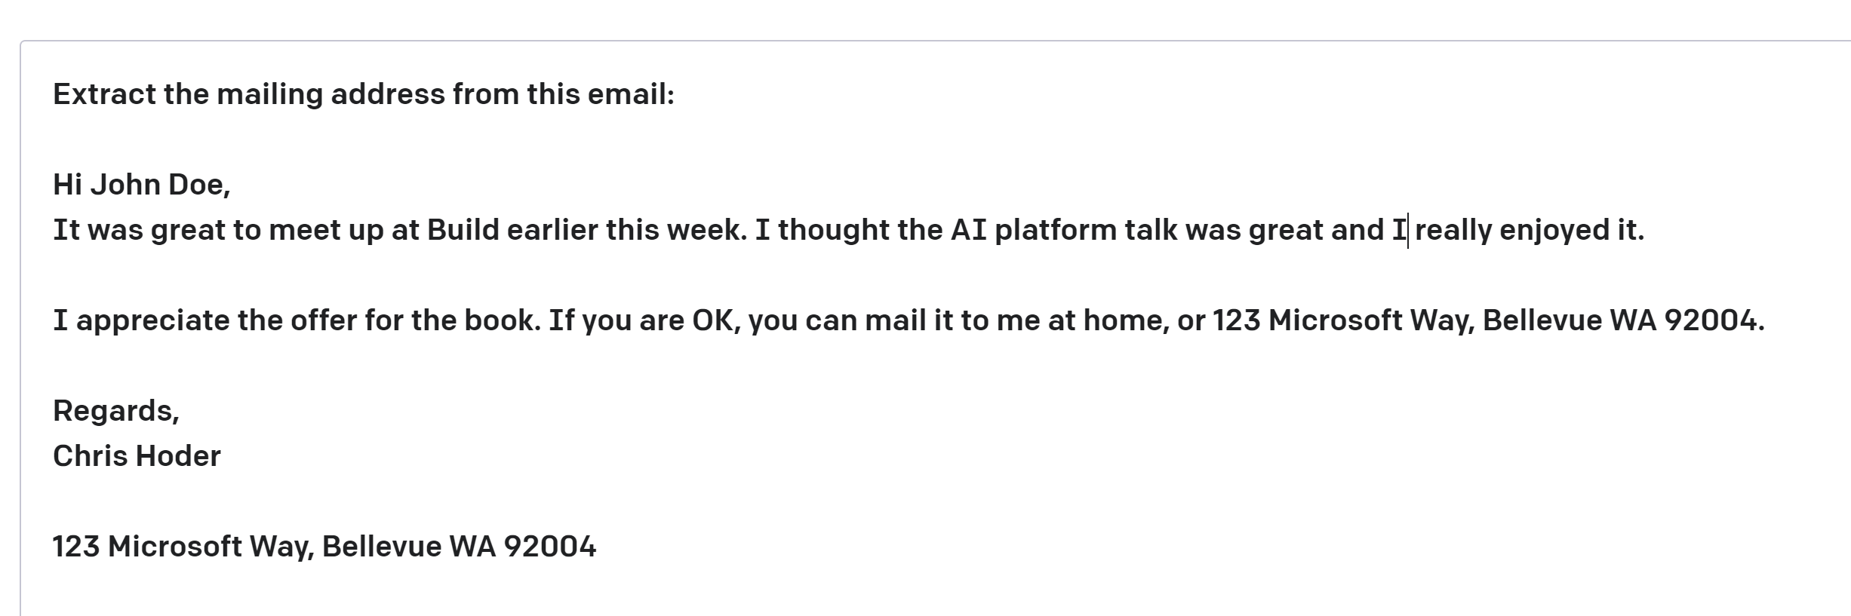
Azure OpenAI | GPT-3 Prompt Design
some context
Completion – Output that GPT-3 generates based on the prompt.
Prompt – Text input that provides some context to the engine on what is expecting.
Notes:
Prompt design (or prompt engineering)
There are three basic guidelines to creating prompts:
Show and tell. Make it clear what you want either through instructions, examples, or a combination of the two. If you want the model to rank a list of items in alphabetical order or to classify a paragraph by sentiment, show it that's what you want.
Provide quality data. If you're trying to build a classifier or get the model to follow a pattern, make sure that there are enough examples. Be sure to proofread your examples — the model is usually smart enough to see through basic spelling mistakes and give you a response, but it also might assume this is intentional and it can affect the response.
Check your settings. The temperature and top_p settings control how deterministic the model is in generating a response. If you're asking it for a response where there's only one right answer, then you'd want to set these lower. If you're looking for more diverse responses, then you might want to set them higher. The number one mistake people use with these settings is assuming that they're "cleverness" or "creativity" controls.

Slide 36


Models and platform roadmap
December 2022
June 2020
Jan 2021
June 2021
Aug 2021
March 2022
Azure OpenAI Service GA
Q1 2023
DALL*E 2 Private Preview
DALL-E and CLIP models
Codex models
Embeddings & Instruction Following Models
GPT-3
Models
+
OpenAI API
Customize
models
(Fine-tuning)
April 2021
Sept 2021
Nov 2021
October 2022
Early 2023
Text-davinci-003
LoRA
Efficient
Fine-tuning
GitHub
Copilot
on Azure
OpenAI
Azure OpenAI
Private preview
Azure OpenAI
Public preview
Codex Fine Tuning
Notes:
General Availability is an important milestone for this service. At GA the service, although still with limited access, comes guaranteed with the enterprise-grade security, SLA, privacy controls, regulatory compliance (e.g. HIPAA), geo diversity (in other words, availability in multiple Azure regions) and support services that customers expect from Microsoft Azure. So, onboarded customers will benefit from these capabilities for the applications they design using the Azure OpenAI Service.
The announcement will consist of an announcement blog post (tentative), availability of this FAQ for Microsoft sales and partners, a Microsoft Mechanics video featuring Pablo Castro (Distinguished Engineer, Microsoft) with crafty demos showing how users can take advantage of this service, and webpage updates.
We are not providing any dates or confirming GPT-4 (tied up in next phase of investment)
GA – December 2021
Text-davinci-003 early 2023
DALL*E 2 private preview Q1 2023

Slide 37
Unlock new use cases
Top Use Cases
Writing assistance | Government agency using Azure OpenAI Service to extract and summarize key information from their extensive library of rural development reports Financial services using Azure OpenAI Service to summarize financial reporting for peer risk analysis and customer conversation summarization
Code generation | Aircraft company using to convert natural language to SQL for aircraft telemetry data Consulting service using Azure OpenAI Service to convert natural language to query propriety data models
Reasoning over data | Financial services firm using Azure OpenAI Service to improve search capabilities and the conversational quality of a customer’s Bot experience. Insurance companies extract information from volumes of unstructured data to automate claim handling processes
Summarization | International insurance company using Azure OpenAI Service to provide summaries of call center customer support conversation logs Global bank using Azure OpenAI Service to summarize financial reporting and analyst articles

Slide 38

Azure OpenAI Service Use Cases
Language
Reason over structured and unstructured data: Classification, Sentiment, Entity Extraction, Search
Refined text-based search with embeddings
Product feedback sentiment
Customer and employee feedback classification
Claims and risk analyses
Support emails and call transcripts
Social media trends
Writing Assistance
Marketing copy / email taglines
Long format text
Paragraphs from bullets
Summarization
Call center call transcripts
Subject Matter Expert Documents
Competitive analysis
Peer Analysis
Technical reports
Product and service feedback
Social media trends
Conversational AI
Smart assists for call centers
Tech support chat bots
Virtual assistants
Artificial humans
Codex
Natural Language to Code
Natural Language to SQL
Code to Natural Language
Code documentation
Refactoring
Use Cases that use multiple model capabilities
Contact Centers
Classification – route mails to appropriate team
Sentiment – prioritize angry customers
Entity extraction and search – analyze liability and risk
Mail and call transcript summarization
Customer response email generation
Rapid response marketing campaigns: classification, sentiment, summarization, content generation, image generation
DALL·E 2
Creative ideation
Podcast and music playlist images
Content syndication
Marketing campaign personalization
Hyper-personalization

